Slide 1
The Robustness of binary image classifiers
-Nathan Nickelson

Slide 2

Why test image classifiers
Self driving automobiles partly navigate with image classification
Understanding what kinds of image corruption affect image classifiers can help make them more robust
The ease of compromising an image classifier is directly proportional to the danger it represents

Slide 3
What is an image classifier
A computer image classifier is generally a multilayered convolutional neural network (CNN) which can take in image input and output categorical information about those images.

Slide 4
What is an image classifier
A Convolutional Neural Network is a deep learning algorithm which can take in an input image, assign importance to various aspects/objects in the image and be able to differentiate one from another.
- Saha, Sumit. 2018. A Comprehensive Guide to Convolutional Neural Networks – The ELI5 Way

Slide 5
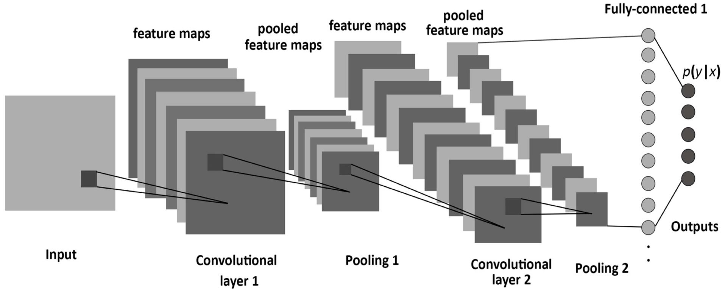
Setting up the network -towards data Science

Slide 6
Setting up the network
16 x 16, 32 x 32, 64 x 64 Images

Slide 7
Setting up the network
8, 16, 32 Filters: Size 3 x 3
Rectified Linear Activation Unit (relu)

Slide 8
Setting up the network
Pooling Layers:
Image Compression 2 x 2

Slide 9
Setting up the network
32, 64, 128 Node Connected
Rectified Linear Activation Unit (relu)

Slide 10
Setting up the network
One Node Output Layer
Sigmoid Function

Slide 11
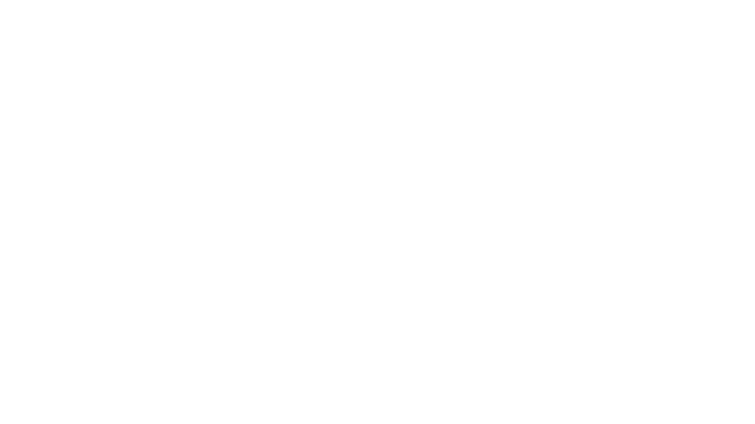
Compile the Convolutional Neural Network
Optimizer algorithm: ADAM
Loss Function: Binary Cross Entropy
Visible Test Metrics: Accuracy
-Kingma, Ba. Adam: A Method for Stochastic Optimization
-Godoy. Understanding Binary Cross-Entropy / Log Loss: A Visual Explanation

Slide 12
Image Preprocessing To prevent similar images from overfitting images are:
Randomly sheared
Randomly zoomed
Randomly flipped horizontally

Slide 13

Testing misclassification: Stop vs Yield (1002 training images, 144 testing images, 60 unknown images)
Image Darkening:
Represents natural lighting environment and possible dirt or film that may get on camera lens
Image Reddening
Represents a physical alteration to the lens to purposefully cause misclassification
Blue/Green Filtering
Same as above

Slide 14
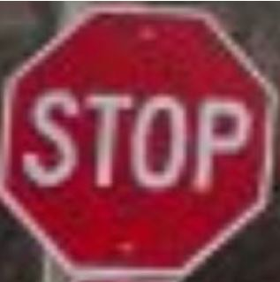
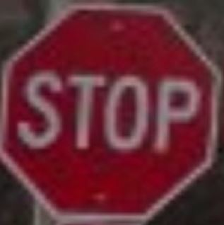
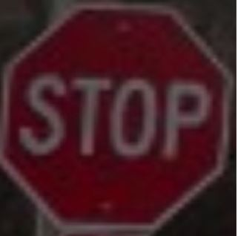
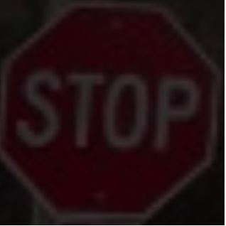
Image Darkening
Normal
75%
50%
25%

Slide 15
Darkening results
Properly classified images were not misclassified with increased shading
5 out of 13 images that were originally misclassified, corrected themselves
Not an effective attack against these machines

Slide 16
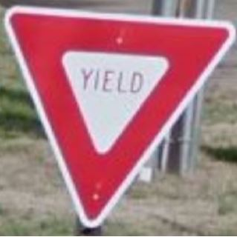
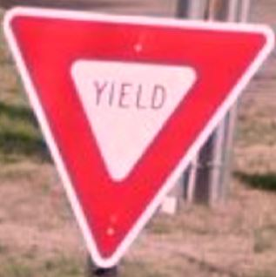
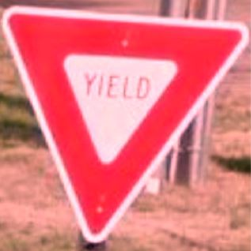
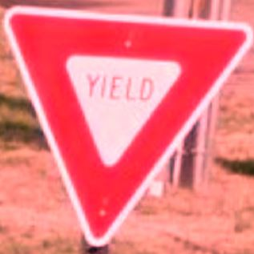
Image Reddening
Normal
1.25 Red Level
1.5 Red Level
1.75 Red Level

Slide 17
Reddening Results
 | Machine 1 | Machine 2 | Machine 3 | Machine 4
Unedited correct % | 91.67% | 100% | 96.7% | 93.3%
# Originally Correct | 26 | 30 | 29 | 26
# of Flipped Images | 25 | 27 | 21 | 26
Average Minimum to Change | 1.49 | 1.86 | 1.94 | 1.99
Min Red Value | 1.25 | 1.25 | 1.25 | 1.25

Slide 18
Reddening results
Reddening caused all models to change yield signs to stop signs
There was no change from stop signs to yield signs
Machine 3 was well balanced and did not over fit

Slide 19
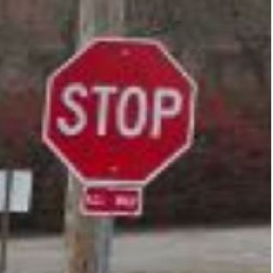
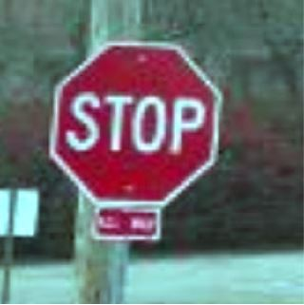
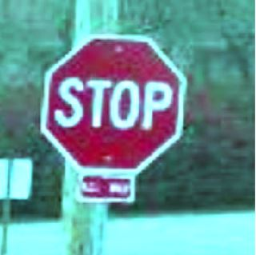
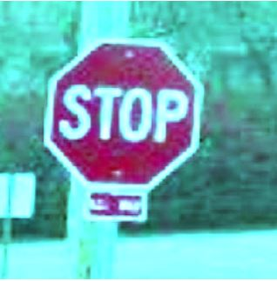
Blue/Green Image Filter
Normal
1.5 BG Level
2.25 BG Level
3.0 BG Level

Slide 20
Blue/Green Filtering Results
 | Machine 1 | Machine 2 | Machine 3 | Machine 4
Unedited correct % | 95% | 95% | 95% | 95%
# Originally Correct | 30 | 28 | 29 | 28
# of Flipped Images | 19 | 13 | 22 | 23
Average Minimum to Change | 2.13 | 1.73 | 2.66 | 2.25
Min Red Value | 1.25 | 1.25 | 1.5 | 1.5

Slide 21
Conclusion
Darkening images could help correct improper classification
01
A simple lens filter could compromise some image classifiers
02
Knowing the boundary areas for misclassification allows for training against these types of attacks
03

Slide 22
References
Tata, Venkatesh. 2017. Simple Image Classification Using a Convolutional Neural Network – Deep Learning in python. Retrieved April 14, 2019 from https://becominghuman.ai/building-an-image-classifier-using-deep-learning-in-python-totally-from-a-beginners-perspective-be8dbaf22dd8
Saha, Sumit. 2018. A Comprehensive Guide to Convolutional Neural Networks – The ELI5 Way. Retrieved April 16, 2019 from https://towardsdatascience.com/a-comprehensive-guide-to-convolutional-neural-networks-the-eli5-way-3bd2b1164a53
Kingma, Diederik P. Ba, Jimmy Lei. Adam: A Method for Stochastic Optimization. arXiv:1412.6980v9. Retrieved from https://arxiv.org/pdf/1412.6980.pdf
Godoy, Daniel. 2018. Understanding Binary Cross-Entropy / Log Loss: A Visual Explanation. Retrieved on April 20, 2019 from https://towardsdatascience.com/understanding-binary-cross-entropy-log-loss-a-visual-explanation-a3ac6025181a
Deshpande, Adit. 2016. A Beginner’s Guide To Understanding Convolutional Neural Networks. Retrievedon April 15, 2019 from https://adeshpande3.github.io/A-Beginner%27s-Guide-To-Understanding-Convolutional-Neural-Networks/

